Slide 1
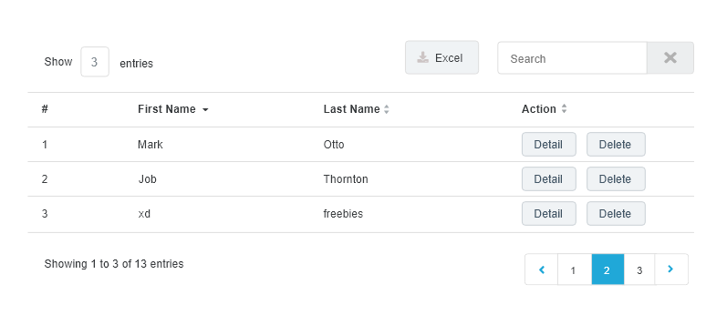
Table

Slide 2




Input, button group
Use for research, register
Use for setting, link in title card

